Slide 1

H172 35 - Object Oriented Analysis and Design
Use Case Diagrams

Slide 2
Use Case Diagram – What is it?
The Use Case Diagram provides a high level view of system functionality from the user’s perspective
The emphasis is on what a system does rather than how
(how is for things like activity, sequence and class diagrams)

Slide 3
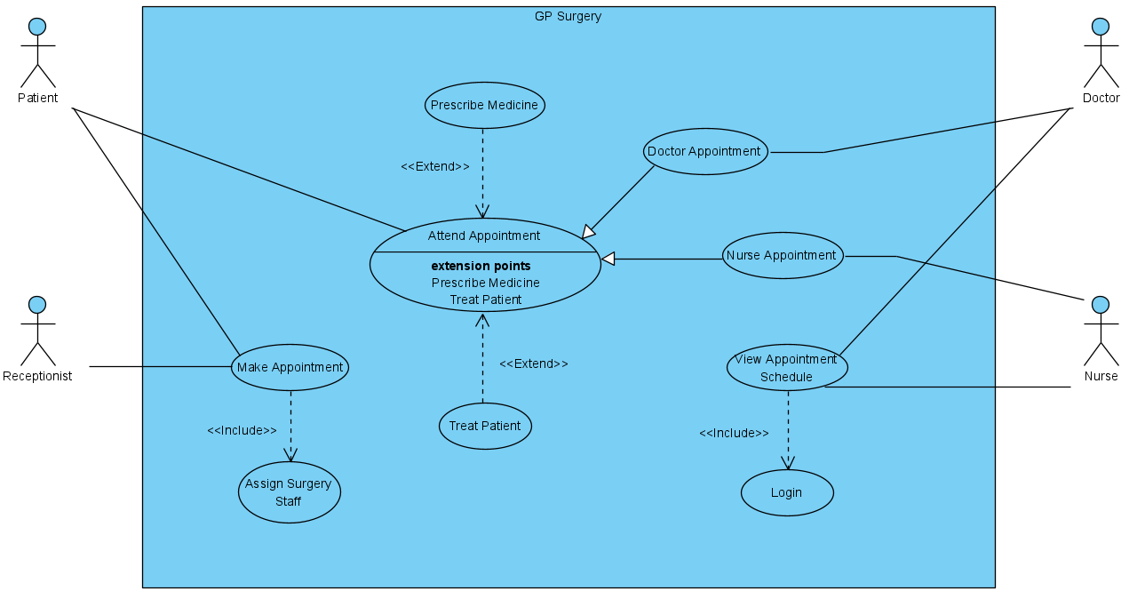
Use Case Example

Slide 4
Use Case Diagram
Components

Slide 5
Use Case Diagram - Components
Actors
Use Cases
Generalisation
Includes
Extends
Notes:
The actors define the systems boundary
usually at the software level
But could be at the business process level

Slide 6

Actor
An Actor is anything outside the system to which the system interfaces
Namely:
Groups of Users
(External) Systems (e.g. payment services like Banks / Credit Cards / Paypal)
An Actor has a ROLE not a specific name (so not “Garry”)
E.g. Actors that would interface with (use) a college system:
Lecturers
Students
Admin Staff
Technicians
Notes:
The actors define the systems boundary
usually at the software level
But could be at the business process level

Slide 7
Use Case
A task that the system can perform
e.g. Buy Ticket | Check Balance | Login
A Use Case is named after the overall task being described
Named in general terms and isn’t too detailed
A Use Case is always connected to at least one Actor
Use Case

Slide 8
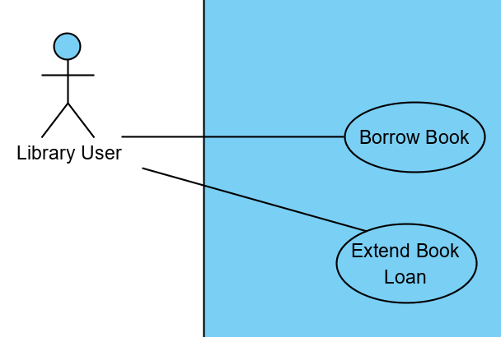
Actor
Use Case
Association:
Shows which Use Cases the actor connects to
A Library User Borrows Books
A Library User Extends their Book Loan

Slide 9
Use Case Generalisation
This is the Use Case terminology for inheritance
As with classes - a child inherits all structure, behavior, and relationships of the parent
The parent Use Case has the generalized name
e.g. Make Payment
Each individual child use case is a specialized version of that parent
E.g. Pay by Credit Card, Pay By Debit Card, Pay By Paypal
Use a line with an arrow to point from the child to the parent

Slide 10
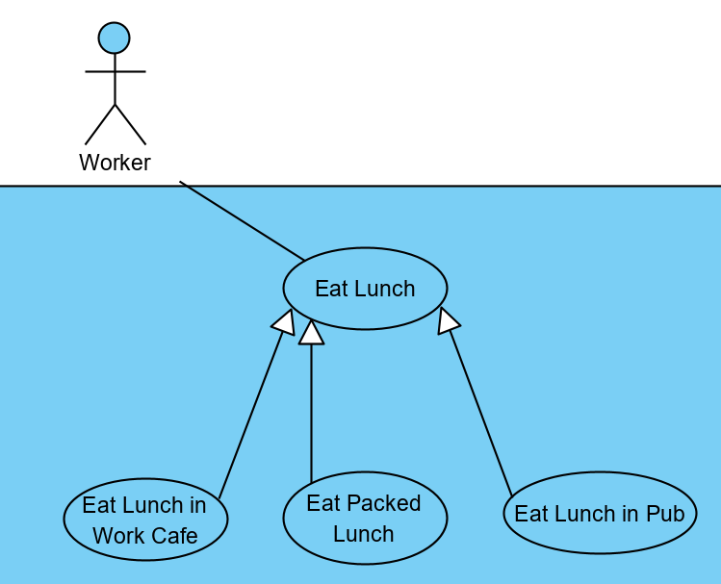
Use Case Generalisation
Parent Use Case
Make Payment
Pay by
Credit card
Pay by
debit card
Child Use Cases

Slide 11
Include Relationship
Some use cases require the actions of another use case to be done to enable it to execute
These use cases show different, but connected actions
For example:
In a shops till system a staff member can’t “Scan Products” until they have “Logged In to Till”
Similarly – once a “Sale is Processed” you must “Print A Receipt”
These are connected use cases that must always be performed together with no exceptions
To draw this - a dashed line is drawn from the use case with an arrow connecting TO the use case that needs to be executed

Slide 12
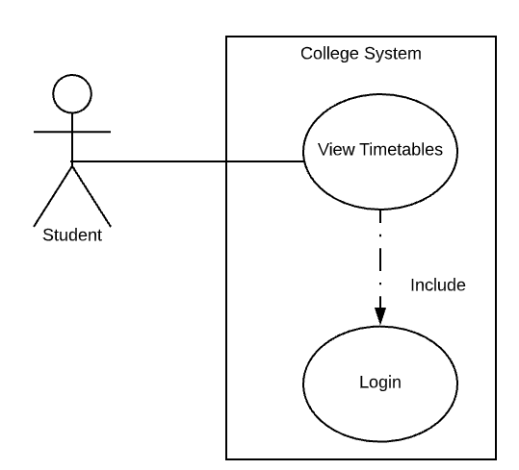
Include Example
Students can VIEW TIMETABLES
But before they can do so, they MUST LOGIN

Slide 13
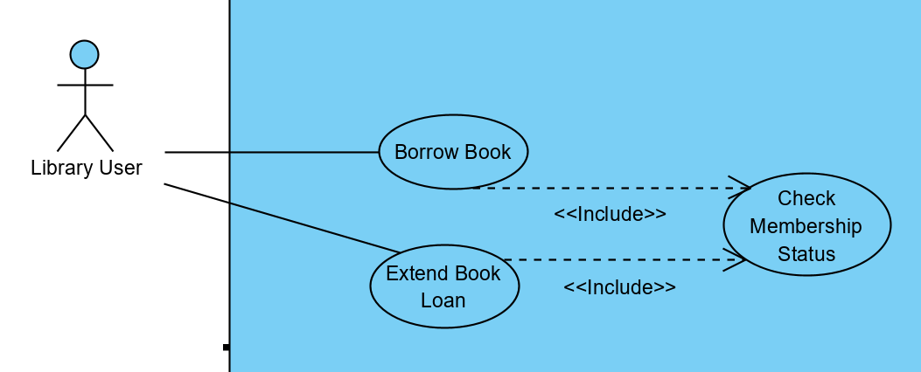
Include Example
In both Use Cases there must ALWAYS be a check to see if the Library Users membership status allows them to use a library facility

Slide 14
Extend Relationship
‘Extend Relationships’ are similar to Includes relationships
It is easy to get these mixed up – so care must be taken!
Extends models situations where the connected use case MAY be called
Includes models situations where the connected use case is ALWAYS
This is basically an IF statement in code!
Used to capture exceptional behaviour or variation from normal behaviour
To draw this - a dashed line is drawn from the use case with an arrow connecting FROM the use case that needs to be extended

Slide 15
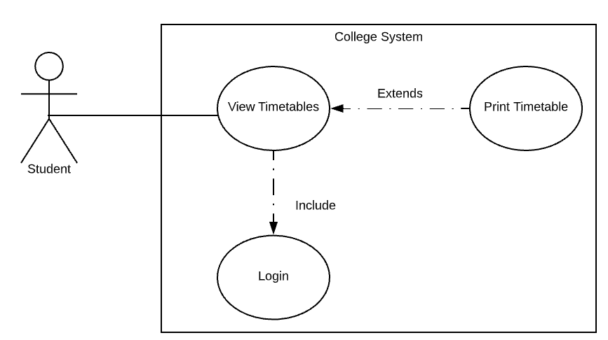
Extends Example
SOMETIMES, Students MAY wish to PRINT TIMETABLES

Slide 16
Some Rules
The Use Case Diagram is a High-Level view of the system
It is supposed to lack detail
Do NOT overuse ‘include’ and ‘extend’ relationships
Do NOT try to connect every use case together. This isn’t always the case.
You are not painting an A – Z story – take each Use Case separately

Slide 17
Basic Notation
Actor | Use case
Include | Extend
Association | Generalisation
Withdraw Cash
<<include>>
Login
<<extend>>
Show Balance
Bid on Item
Withdraw Cash
Make Payment
Cash Payment
Make Payment
Actor

Slide 18
Further Reading
Visual Paradigm have explanations and examples of all the major diagram types
If you’re looking for more info or want another “voice” to describe it to you – look here:
https://www.visual-paradigm.com/guide/uml-unified-modeling-language/what-is-use-case-diagram/

